Slide 1
Matrix Multiplication
Matrix Chain Multiplication by Dynamic Programming
Spring 2022

Slide 2
Outline
Outline
Review of matrix multiplication.
The chain matrix multiplication problem.
A dynamic programming algorithm for chain matrix multiplication.
Chain Matrix Multiplication
2 / 27

Slide 3
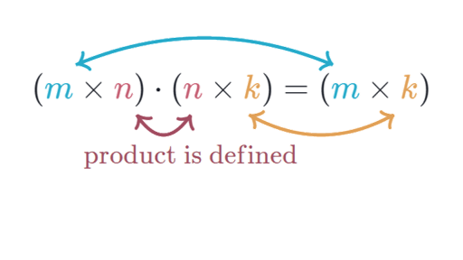
Rules to multiply Two Matrices
The number of columns of the 1st matrix must equal the number of rows of the 2nd matrix.
And the result will have the same number of rows as the 1st matrix, and the same number of columns as the 2nd matrix.

Slide 4
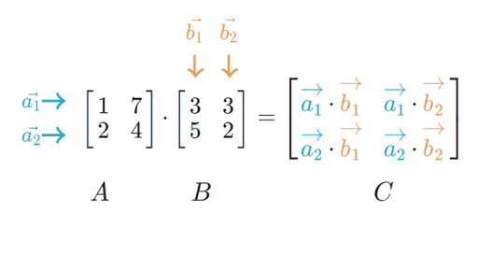
Matrix Multiplication

Slide 5
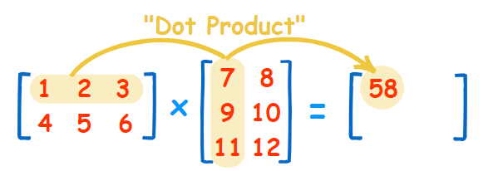
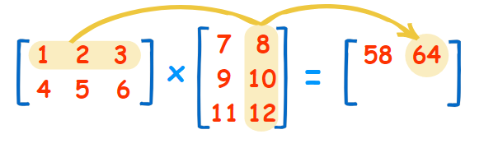
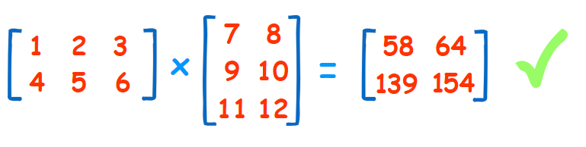
Matrix Multiplication

Slide 6
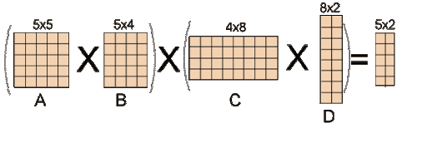

Slide 7
Review of Matrix Multiplication
Matrix: An n × m matrix A = [a[i , j ]] is a two-dimensional array
a[1, 1]
a[2, 1]
· · · a[1, m − 1]
· · ·
. .
a[n, 1] a[n, 2] · · ·
a[1, 2]
a[2, 2]
a[1, m]
a[2, m]
a[2, m − 1]
A =
,
.
.
.
.
. .
a[n, m − 1] a[n, m]
which has n rows and m columns. Example
A 4 × 5 matrix:
12 8 9 7 6
7 6 89 56 2
5 5 6 9 10
8 6 0 −8 −1
.
Chain Matrix Multiplication
7 / 27

Slide 8
Review of Matrix Multiplication
The product C = AB of a p × q matrix A and a q × r matrix B is a p × r matrix C given by
q
c[i, j ] = a[i, k]b[k, j ], for 1 ≤ i ≤ p and 1 ≤ j ≤ r
k=1
Σ
Chain Matrix Multiplication
4 / 27

Slide 9
Review of Matrix Multiplication
The product C = AB of a p × q matrix A and a q × r matrix B is a p × r matrix C given by
q
c[i, j ] = a[i, k]b[k, j ], for 1 ≤ i ≤ p and 1 ≤ j ≤ r
k=1
Σ
Complexity of Matrix multiplication: Note that C has pr entries and each entry takesΘ( q)time to compute so the total procedure takes Θ(pqr ) time.
Chain Matrix Multiplication
4 / 27

Slide 10
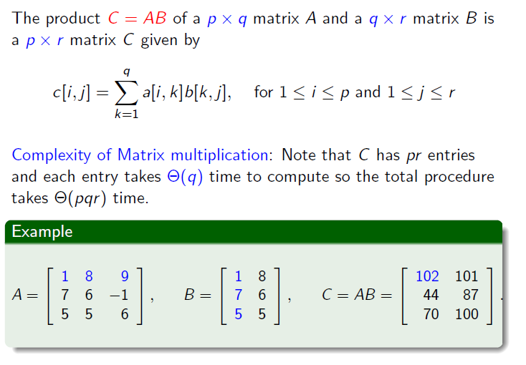
Review of Matrix

Slide 11
Remarks on Matrix Multiplication
Matrix multiplication is associative, e.g.,
Chain Matrix Multiplication
5 / 27

Slide 12
Remarks on Matrix Multiplication
Matrix multiplication is associative, e.g.,
A₁A₂A₃ = (A₁A₂)A₃ = A₁(A₂A₃),
so parenthesization does not change result.
Chain Matrix Multiplication
5 / 27

Slide 13
Remarks on Matrix Multiplication
Matrix multiplication is associative, e.g.,
A₁A₂A₃ = (A₁A₂)A₃ = A₁(A₂A₃),
so parenthesization does not change result.
Matrix multiplication is NOT commutative, e.g.,
Chain Matrix Multiplication
5 / 27

Slide 14
Remarks on Matrix Multiplication
Matrix multiplication is associative, e.g.,
A₁A₂A₃ = (A₁A₂)A₃ = A₁(A₂A₃),
so parenthesization does not change result.
Matrix multiplication is NOT commutative, e.g.,
A₁A_{2 ≠} A₂A₁
Chain Matrix Multiplication
5 / 27

Slide 15
Matrix Multiplication of ABC
Given p × q matrix A, q × r matrix B and r × s matrix C ,
ABC can be computed in two ways:
Chain Matrix Multiplication
6 / 27

Slide 16
Matrix Multiplication of ABC
Given p × q matrix A, q × r matrix B and r × s matrix C ,
ABC can be computed in two ways: (AB)C and A(BC )
Chain Matrix Multiplication
6 / 27

Slide 17
Matrix Multiplication of ABC
Given p × q matrix A, q × r matrix B and r × s matrix C ,
ABC can be computed in two ways: (AB)C and A(BC )
The number of multiplications needed are:
mult[(AB)C ] = pqr + prs,
mult[A(BC )] = qrs + pqs.
Chain Matrix Multiplication
6 / 27

Slide 18
Matrix Multiplication of ABC
Given p × q matrix A, q × r matrix B and r × s matrix C ,
ABC can be computed in two ways: (AB)C and A(BC )
The number of multiplications needed are:
mult[(AB)C ] = pqr + prs,
mult[A(BC )] = qrs + pqs.
Example
For p = 5, q = 4, r = 6 and s = 2,
mult[(AB)C ] = 180,
mult[A(BC )] = 88.
A big difference!
Chain Matrix Multiplication
6 / 27

Slide 19
Matrix Multiplication of ABC
Given p × q matrix A, q × r matrix B and r × s matrix C ,
ABC can be computed in two ways: (AB)C and A(BC )
The number of multiplications needed are:
mult[(AB)C ] = pqr + prs,
mult[A(BC )] = qrs + pqs.
Example
For p = 5, q = 4, r = 6 and s = 2,
mult[(AB)C ] = 180,
mult[A(BC )] = 88.
A big difference!
Implication: Multiplication “sequence” (parenthesization) is important!!
Chain Matrix Multiplication
6 / 27

Slide 20
Conclusion
Order of operations makes a huge difference. How do we compute the minimum?
Each parenthesization defines a set of n-1 matrix multiplications. We just need to pick the parenthesization that corresponds to the best ordering.
Trying all possible parenthesizations is a bad idea!!!

Slide 21
Outline
Review of matrix multiplication.
The chain matrix multiplication problem.
A dynamic programming algorithm for chain matrix multiplication.
Chain Matrix Multiplication
7 / 27

Slide 22
The Chain Matrix Multiplication Problem
Definition (Chain matrix multiplication problem)
Given dimensions p₀, p₁, . . . , p_{n}, corresponding to matrix sequence A₁, A₂, . . ., A_{n} in which A_{i} has dimension p_{i−1} × p_{i} , determine the “multiplication sequence”that minimizes the number of scalar multiplications in computing A₁A₂ · · · A_{n}.
i.e.,, determine how to parenthesize the multiplications.
Chain Matrix Multiplication
8 / 27

Slide 23
The Chain Matrix Multiplication Problem
Definition (Chain matrix multiplication problem)
Given dimensions p₀, p₁, . . . , p_{n}, corresponding to matrix sequence A₁, A₂, . . ., A_{n} in which A_{i} has dimension p_{i−1} × p_{i} , determine the “multiplication sequence” that minimizes the number of scalar multiplications in computing A₁A₂ · · · A_{n}.
i.e.,, determine how to parenthesize the multiplications.
Example
A₁A₂A₃A₄ = (A₁A₂)(A₃A₄) = A₁(A₂(A₃A₄)) = A₁((A₂A₃)A₄)
= ((A₁A₂)A₃)(A₄) = (A₁(A₂A₃))(A₄)
Exhaustive search: Ω(4^{n}/n^{3/2}).
Chain Matrix Multiplication
8 / 27

Slide 24
The Chain Matrix Multiplication Problem
Definition (Chain matrix multiplication problem)
Given dimensions p₀, p₁, . . . , p_{n}, corresponding to matrix sequence A₁, A₂, . . ., A_{n} in which A_{i} has dimension p_{i−1} × p_{i} , determine the “multiplication sequence” that minimizes the number of scalar multiplications in computing A₁A₂ · · · A_{n}.
i.e.,, determine how to parenthesize the multiplications.
Example
A₁A₂A₃A₄ = (A₁A₂)(A₃A₄) = A₁(A₂(A₃A₄)) = A₁((A₂A₃)A₄)
= ((A₁A₂)A₃)(A₄) = (A₁(A₂A₃))(A₄)
Exhaustive search: Ω(4^{n}/n^{3/2}).
Question
Is there a better approach?
Chain Matrix Multiplication
8 / 27

Slide 25
The Chain Matrix Multiplication Problem
Definition (Chain matrix multiplication problem)
Given dimensions p₀, p₁, . . . , p_{n}, corresponding to matrix sequence A₁, A₂, . . ., A_{n} in which A_{i} has dimension p_{i−1} × p_{i} , determine the “multiplication sequence” that minimizes the number of scalar multiplications in computing A₁A₂ · · · A_{n}.
i.e.,, determine how to parenthesize the multiplications.
Example
A₁A₂A₃A₄ = (A₁A₂)(A₃A₄) = A₁(A₂(A₃A₄)) = A₁((A₂A₃)A₄)
= ((A₁A₂)A₃)(A₄) = (A₁(A₂A₃))(A₄)
Exhaustive search: Ω(4^{n}/n^{3/2}). Question
Is there a better approach?
Yes – DP
Chain Matrix Multiplication
8 / 27

Slide 26
Developing a Dynamic Programming Algorithm
Step 1: Define Space of Subproblems
Chain Matrix Multiplication
10 / 27

Slide 27
Developing a Dynamic Programming Algorithm
Step 1: Define Space of Subproblems
Original Problem:
Determine minimal cost multiplication sequence for A_{1..n}.
Chain Matrix Multiplication
10 / 27

Slide 28
Developing a Dynamic Programming Algorithm
Step 1: Define Space of Subproblems
Original Problem:
Determine minimal cost multiplication sequence for A_{1..n}.
Subproblems: For every pair 1 ≤ i ≤ j ≤ n:
Determine minimal cost multiplication sequence for
A_{i..j} = A_{i} A_{i +1} · · · A_{j} .
Note that A_{i..j} is a p_{i−1} × p_{j} matrix.
Chain Matrix Multiplication
10 / 27

Slide 29
Example:
dimension p_{i-1}×p_{i}
i=1
Given a chain A₁, A₂, …, A_{n} of n matrices, where for i=1, 2, …, n, matrix A_{i} has dimension p_{i-1}×p_{i}

Slide 30
Note
In the matrix-chain multiplication problem, we are not actually multiplying matrices.
Our goal is only to determine an order for multiplying matrices that has the lowest cost.
Typically, the time invested in determining this optimal order is more than paid for by the time saved later on when actually performing the matrix multiplications (such as performing only 7500 scalar multiplications instead of 75,000).

Slide 31
Developing a Dynamic Programming Algorithm
Step 1: Define Space of Subproblems
Original Problem:
Determine minimal cost multiplication sequence for A_{1..n}.
Subproblems: For every pair 1 ≤ i ≤ j ≤ n:
Determine minimal cost multiplication sequence for
A_{i..j} = A_{i} A_{i +1} · · · A_{j} .
Note that A_{i..j} is a p_{i−1} × p_{j} matrix.
There are Θ(n ) such subproblems. (Why?)
2
How can we solve larger problems using subproblem solutions?
Chain Matrix Multiplication
10 / 27

Slide 32
Relationships among subproblems
At the last step of any optimal multiplication sequence (for a subbroblem), there is some k such that the two matrices A_{i..k} and A_{k+1..j} are multipled together.
Chain Matrix Multiplication
11 / 27

Slide 33
Relationships among subproblems
At the last step of any optimal multiplication sequence (for a subbroblem), there is some k such that the two matrices A_{i..k} and A_{k+1..j} are multipled together. That is,
A_{i..j} = (A_{i} · · · A_{k} ) (A_{k+1} · · · A_{j} )
Chain Matrix Multiplication
11 / 27

Slide 34
Relationships among subproblems
At the last step of any optimal multiplication sequence (for a subbroblem), there is some k such that the two matrices A_{i..k} and A_{k+1..j} are multipled together. That is,
A_{i..j} = (A_{i} · · · A_{k} ) (A_{k+1} · · · A_{j} ) = A_{i..k} A_{k+1..j} .
Chain Matrix Multiplication
11 / 27

Slide 35
Relationships among subproblems
At the last step of any optimal multiplication sequence (for a subbroblem), there is some k such that the two matrices A_{i..k} and A_{k+1..j} are multipled together. That is,
A_{i..j} = (A_{i} · · · A_{k} ) (A_{k+1} · · · A_{j} ) = A_{i..k} A_{k+1..j} .
Question
How do we decide where to split the chain (what is k)?
Chain Matrix Multiplication
11 / 27

Slide 36
Relationships among subproblems
At the last step of any optimal multiplication sequence (for a subbroblem), there is some k such that the two matrices A_{i..k} and A_{k+1..j} are multipled together. That is,
A_{i..j} = (A_{i} · · · A_{k} ) (A_{k+1} · · · A_{j} ) = A_{i..k} A_{k+1..j} .
Question
How do we decide where to split the chain (what is k)?
ANS: Can be any k. Need to check all possible values.
Chain Matrix Multiplication
11 / 27

Slide 37
Relationships among subproblems
At the last step of any optimal multiplication sequence (for a subbroblem), there is some k such that the two matrices A_{i..k} and A_{k+1..j} are multipled together. That is,
A_{i..j} = (A_{i} · · · A_{k} ) (A_{k+1} · · · A_{j} ) = A_{i..k} A_{k+1..j} .
Question
How do we decide where to split the chain (what is k)?
ANS: Can be any k. Need to check all possible values. Question
How do we parenthesize the two subchains A_{i..k} and A_{k+1..j} ?
Chain Matrix Multiplication
11 / 27

Slide 38
Relationships among subproblems
At the last step of any optimal multiplication sequence (for a subbroblem), there is some k such that the two matrices A_{i..k} and A_{k+1..j} are multipled together. That is,
A_{i..j} = (A_{i} · · · A_{k} ) (A_{k+1} · · · A_{j} ) = A_{i..k} A_{k+1..j} .
Question
How do we decide where to split the chain (what is k)?
ANS: Can be any k. Need to check all possible values. Question
How do we parenthesize the two subchains A_{i..k} and A_{k+1..j} ?
ANS: A_{i..k} and A_{k+1..j} must be computed optimally, so we can apply the same procedure recursively.
Chain Matrix Multiplication
11 / 27

Slide 39
Optimal Structure Property
If the “optimal” solution of A_{i..j} involves splitting into A_{i..k} and A_{k+1..j} at the final step, then parenthesization of A_{i..k} and A_{k+1..j} in the optimal solution must also beoptimal
Chain Matrix Multiplication
12 / 27

Slide 40
Optimal Structure Property
If the “optimal” solution of A_{i..j} involves splitting into A_{i..k} and A_{k+1..j} at the final step, then parenthesization of A_{i..k} and A_{k+1..j} in the optimal solution must also be optimal
If parenthesization of A_{i..k} was not optimal, it could be replaced by a cheaper parenthesization, yielding a cheaper final solution, constradicting optimality
Chain Matrix Multiplication
12 / 27

Slide 41
Optimal Structure Property
If the “optimal” solution of A_{i..j} involves splitting into A_{i..k} and A_{k+1..j} at the final step, then parenthesization of A_{i..k} and A_{k+1..j} in the optimal solution must also be optimal
If parenthesization of A_{i..k} was not optimal, it could be replaced by a cheaper parenthesization, yielding a cheaper final solution, constradicting optimality
Similarly, if parenthesization of A_{k+1..j} was not optimal, it could be replaced by a cheaper parenthesization, again yielding contradiction of cheaper final solution.
Chain Matrix Multiplication
12 / 27

Slide 42
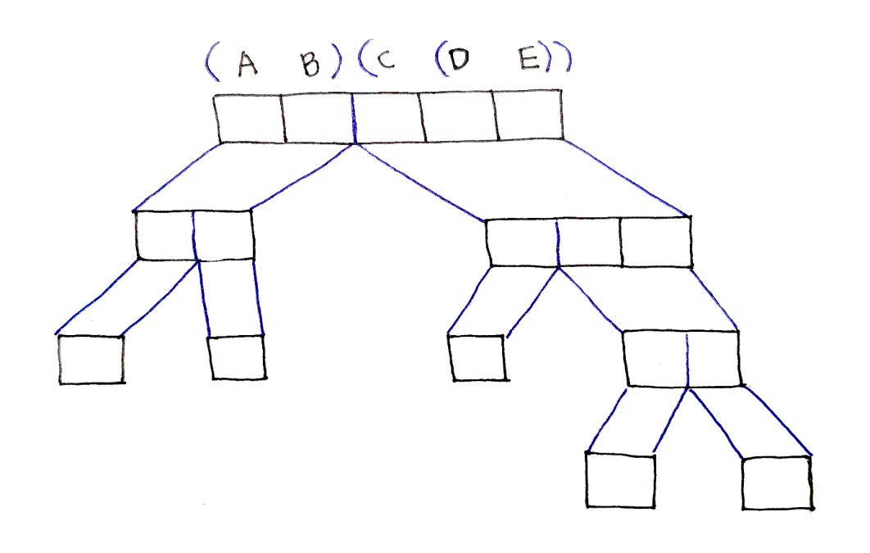
Dynamic Programming Approach
A
B
C
D
E

Slide 43
Relationships among subproblems
Step 2: Constructing optimal solutions from optimal subproblem solution
Chain Matrix Multiplication
13 / 27

Slide 44
Relationships among subproblems
Step 2: Constructing optimal solutions from optimal subproblem solution
For 1 ≤ i ≤ j ≤ n, let m[i, j ] denote the minimum number of multiplications needed to compute A_{i..j} . This optimum cost must satisify the following recursive definition.
Chain Matrix Multiplication
13 / 27

Slide 45
Relationships among subproblems
Step 2: Constructing optimal solutions from optimal subproblem solution
For 1 ≤ i ≤ j ≤ n, let m[i, j ] denote the minimum number of multiplications needed to compute A_{i..j} . This optimum cost must satisify the following recursive definition.
.
0 i = j ,
min_{i≤k<j} (m[i, k] + m[k + 1, j ] + p_{i−1}p_{k} p_{j} ) i < j
m[i, j ] =
Chain Matrix Multiplication
13 / 27

Slide 46
Relationships among subproblems
Step 2: Constructing optimal solutions from optimal subproblem solution
For 1 ≤ i ≤ j ≤ n, let m[i, j ]denote the minimum number of multiplications needed to compute A_{i..j} . This optimum cost must satisify the following recursive definition.
.
0 i = j ,
min_{i≤k<j} (m[i, k] + m[k + 1, j ] + p_{i−1}p_{k} p_{j} ) i < j
m[i, j ] =
^{A}i..j ^{= A}i..k ^{A}k+1..j
Chain Matrix Multiplication
13 / 27

Slide 47
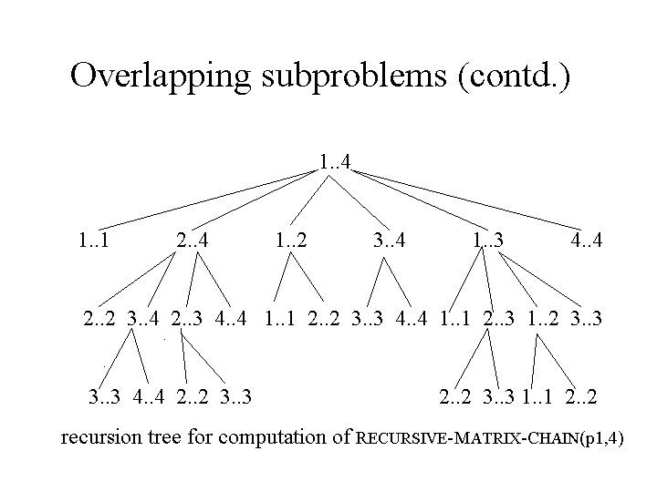

Slide 48
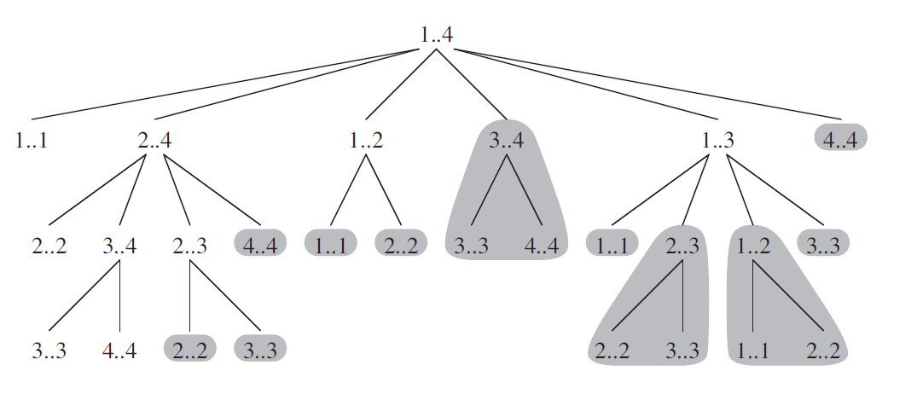
Overlapping Sub-Problems

Slide 49
Developing a Dynamic Programming Algorithm
Step 3:
Bottom-up computation of m[i, j ].
Chain Matrix Multiplication
16 / 27

Slide 50
Developing a Dynamic Programming Algorithm
Step 3:
Bottom-up computation of m[i, j ].
Recurrence:
m[i, j ] = _{i} min (m[i, k] + m[k + 1, j ] + p_{i−1}p_{k} p_{j} )
≤k<j
Chain Matrix Multiplication
16 / 27

Slide 51
Developing a Dynamic Programming Algorithm
Step 3:
Bottom-up computation of m[i, j ].
Recurrence:
m[i, j ] = min (m[i, k] + m[k + 1, j ] + p_{i−1}p_{k} p_{j} )
i
≤k<j
Fill in the m[i, j ] table in an order, such that when it is time to calculate m[i, j ], the values of m[i, k] and m[k + 1, j ] for all k are already available.
Chain Matrix Multiplication
16 / 27

Slide 52
Developing a Dynamic Programming Algorithm
Step 3:
Bottom-up computation of m[i, j ].
Recurrence:
m[i, j ] = min (m[i, k] + m[k + 1, j ] + p_{i−1}p_{k} p_{j} )
i
≤k<j
Fill in the m[i, j ] table in an order, such that when it is time to calculate m[i, j ], the values of m[i, k] and m[k + 1, j ] for all k are already available.
An easy way to ensure this is to compute them in increasing order of the size (j − i ) of the matrix-chain A_{i..j} :
m[1, 2], m[2, 3], m[3, 4], . . . , m[n − 3, n − 2], m[n − 2, n − 1], m[n − 1, n]
Set of 2 Matrices
Chain Matrix Multiplication
16 / 27

Slide 53
Developing a Dynamic Programming Algorithm
Step 3:
Bottom-up computation of m[i, j ].
Recurrence:
m[i, j ] = min (m[i, k] + m[k + 1, j ] + p_{i−1}p_{k} p_{j} )
i
≤k<j
Fill in the m[i, j ] table in an order, such that when it is time to calculate m[i, j ], the values of m[i, k] and m[k + 1, j ] for all k are already available.
An easy way to ensure this is to compute them in increasing order of the size (j − i ) of the matrix-chain A_{i..j} :
m[1, 2], m[2, 3], m[3, 4], . . . , m[n − 3, n − 2], m[n − 2, n − 1], m[n − 1, n]
m[1, 3], m[2, 4], m[3, 5], . . . , m[n − 3, n − 1], m[n − 2, n]
Set of 3 Matrices
Chain Matrix Multiplication
16 / 27

Slide 54
Developing a Dynamic Programming Algorithm
Step 3:
Bottom-up computation of m[i, j ].
Recurrence:
m[i, j ] = min (m[i, k] + m[k + 1, j ] + p_{i−1}p_{k} p_{j} )
i
≤k<j
Fill in the m[i, j ] table in an order, such that when it is time to calculate m[i, j ], the values of m[i, k] and m[k + 1, j ] for all k are already available.
An easy way to ensure this is to compute them in increasing order of the size (j − i ) of the matrix-chain A_{i..j} :
m[1, 2], m[2, 3], m[3, 4], . . . , m[n − 3, n − 2], m[n − 2, n − 1], m[n − 1, n]
m[1, 3], m[2, 4], m[3, 5], . . . , m[n − 3, n − 1], m[n − 2, n]
m[1, 4], m[2, 5], m[3, 6], . . . , m[n − 3, n]
Set of 4 Matrices
Chain Matrix Multiplication
16 / 27

Slide 55
Developing a Dynamic Programming Algorithm
Step 3:
Bottom-up computation of m[i, j ].
Recurrence:
m[i, j ] = min (m[i, k] + m[k + 1, j ] + p_{i−1}p_{k} p_{j} )
i
≤k<j
Fill in the m[i, j ] table in an order, such that when it is time to calculate m[i, j ], the values of m[i, k] and m[k + 1, j ] for all k are already available.
An easy way to ensure this is to compute them in increasing order of the size (j − i ) of the matrix-chain A_{i..j} :
m[1, 2], m[2, 3], m[3, 4], . . . , m[n − 3, n − 2], m[n − 2, n − 1], m[n − 1, n]
m[1, 3], m[2, 4], m[3, 5], . . . , m[n − 3, n − 1], m[n − 2, n]
m[1, 4], m[2, 5], m[3, 6], . . . , m[n − 3, n]
. . .
m[1, n − 1], m[2, n]
Chain Matrix Multiplication
16 / 27

Slide 56
Developing a Dynamic Programming Algorithm
Step 3:
Bottom-up computation of m[i, j ].
Recurrence:
m[i, j ] = min (m[i, k] + m[k + 1, j ] + p_{i−1}p_{k} p_{j} )
i
≤k<j
Fill in the m[i, j ] table in an order, such that when it is time to calculate m[i, j ], the values of m[i, k] and m[k + 1, j ] for all k are already available.
An easy way to ensure this is to compute them in increasing order of the size (j − i ) of the matrix-chain A_{i..j} :
m[1, 2], m[2, 3], m[3, 4], . . . , m[n − 3, n − 2], m[n − 2, n − 1], m[n − 1, n]
m[1, 3], m[2, 4], m[3, 5], . . . , m[n − 3, n − 1], m[n − 2, n]
m[1, 4], m[2, 5], m[3, 6], . . . , m[n − 3, n]
. . .
m[1, n − 1], m[2, n]
m[1, n]
Chain Matrix Multiplication

Slide 57
Example for the Bottom-Up Computation
Example
A chain of four matrices A₁, A₂, A₃ and A₄, with
p₀ = 5, p₁ = 4, p₂ = 6, p₃ = 2 and p₄ = 7. Find m[1, 4].
Chain Matrix Multiplication
17 / 27

Slide 58
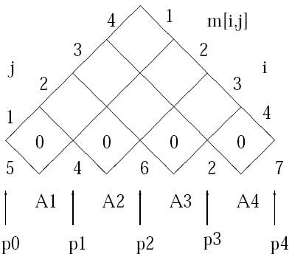
Example for the Bottom-Up Computation
Example
A chain of four matrices A₁, A₂, A₃ and A₄, with
p₀ = 5, p₁ = 4, p₂ = 6, p₃ = 2 and p₄ = 7. Find m[1, 4].
S0: Initialization
Chain Matrix Multiplication
17 / 27

Slide 59
Example – Continued
Step 1: Computing m[1, 2]
A1_{5x4 ,} A2_{4x6 ,} A3_{6x2 ,} A4_{2x7}
 | 1 | 2 | 3 | 4
1 | 0
2 | NA | 0
3 | NA | NA | 0
4 | NA | NA | NA | 0
A1_{5x4} A2_{4x6}
COST= 5 x 4 x 6=120
M [1,2]= 120
Chain Matrix Multiplication
18 / 27

Slide 60
Example – Continued
Step 1: Computing m[1, 2]
A1_{5x4 ,} A2_{4x6 ,} A3_{6x2 ,} A4_{2x7}
 | 1 | 2 | 3 | 4
1 | 0 | 120
2 | NA | 0
3 | NA | NA | 0
4 | NA | NA | NA | 0
A1_{5x4} A2_{4x6}
COST= 5 x 4 x 6=120
M [1,2]= 120
Chain Matrix Multiplication
18 / 27

Slide 61
Example – Continued
Step 1: Computing m[2, 3]
A1_{5x4 ,} A2_{4x6 ,} A3_{6x2 ,} A4_{2x7}
 | 1 | 2 | 3 | 4
1 | 0 | 120
2 | NA | 0 | 48
3 | NA | NA | 0
4 | NA | NA | NA | 0
A2_{4x6} A3_{6x2}
COST= 4 x 6 x 2=48
M [2, 3]= 48
Chain Matrix Multiplication
18 / 27

Slide 62
Example – Continued
Step 1: Computing m[3, 4]
A1_{5x4 ,} A2_{4x6 ,} A3_{6x2 ,} A4_{2x7}
 | 1 | 2 | 3 | 4
1 | 0 | 120
2 | NA | 0 | 48
3 | NA | NA | 0 | 84
4 | NA | NA | NA | 0
A3_{6x2} A4_{2x7}
COST= 6 x 2 x 7=84
M [3,4]= 84
Chain Matrix Multiplication
18 / 27

Slide 63
Example – Continued
Step 1: Computing m[1, 3]
A1_{5x4 ,} A2_{4x6 ,} A3_{6x2 ,} A4_{2x7}
 | 1 | 2 | 3 | 4
1 | 0 | 120
2 | NA | 0 | 48
3 | NA | NA | 0 | 84
4 | NA | NA | NA | 0
A1. ( A2 . A3) or (A1. A2 ). A3
Two Possibilities to multiply 3 matrices
Chain Matrix Multiplication
18 / 27

Slide 64
Example – Continued
Step 1: Computing m[1, 3]
A1_{5x4 ,} A2_{4x6 ,} A3_{6x2 ,} A4_{2x7}
A1. ( A2 . A3) or (A1. A2 ). A3
A1_{5x4 ,} ( A2_{4x6 ,} A3_{6x2 )}
=m[1,1]+m[2,3]+5*4*2
=0+ 48 + 40
=88
(A1_{5x4 .} A2_{4x6 )} . A3_{6x2}
= m[1,2]+ m[3,3]+ 5x6x2
=120 + 0 + 60
=180
Pick Minimum
Two Possibilities to multiply 3 matrices
Chain Matrix Multiplication
18 / 27

Slide 65
Example – Continued
Step 1: Computing m[1, 3]
A1_{5x4 ,} A2_{4x6 ,} A3_{6x2 ,} A4_{2x7}
 | 1 | 2 | 3 | 4
1 | 0 | 120 | 88
2 | NA | 0 | 48
3 | NA | NA | 0 | 84
4 | NA | NA | NA | 0
A1. ( A2 . A3) or (A1. A2 ). A3
Two Possibilities to multiply 3 matrices
Chain Matrix Multiplication
18 / 27

Slide 66
Example – Continued
Step 1: Computing m[2, 4]
A1_{5x4 ,} A2_{4x6 ,} A3_{6x2 ,} A4_{2x7}
 | 1 | 2 | 3 | 4
1 | 0 | 120 | 88
2 | NA | 0 | 48
3 | NA | NA | 0 | 84
4 | NA | NA | NA | 0
A2. ( A3 . A4) or (A2. A3 ). A4
Two Possibilities to multiply 3 matrices
Chain Matrix Multiplication
18 / 27

Slide 67
Example – Continued
Step 1: Computing m[2, 4]
A1_{5x4 ,} A2_{4x6 ,} A3_{6x2 ,} A4_{2x7}
A2. ( A3 . A4) or (A2. A3 ). A4
A2_{4x6 .} ( A3_{6x2 ,} A4_{2x7 )}
=m[2,2]+m[3,4]+ 4x6x7
=0+ 84 + 168
=252
(A2_{4x6 .} A3_{6x2) .} A4_{2x7}
= m[1,2]+ m[3,3]+ 4x2x7
=48 + 0 + 56
=104
Pick Minimum
Two Possibilities to multiply 3 matrices
Chain Matrix Multiplication
18 / 27

Slide 68
Example – Continued
Step 1: Computing m[2,4 ]
A1_{5x4 ,} A2_{4x6 ,} A3_{6x2 ,} A4_{2x7}
 | 1 | 2 | 3 | 4
1 | 0 | 120 | 88
2 | NA | 0 | 48 | 104
3 | NA | NA | 0 | 84
4 | NA | NA | NA | 0
A1. ( A2 . A3) or (A1. A2 ). A3
Two Possibilities to multiply 3 matrices
Chain Matrix Multiplication
18 / 27

Slide 69
Example – Continued
Step 1: Computing m[2, 4]
A1_{5x4 ,} A2_{4x6 ,} A3_{6x2 ,} A4_{2x7}
 | 1 | 2 | 3 | 4
1 | 0 | 120 | 88
2 | NA | 0 | 48 | 104
3 | NA | NA | 0 | 84
4 | NA | NA | NA | 0
A1. ( A2 . A3. A4) or (A1. A2 ). ( A3 . A4) or (A1 .A2. A3). A4
Three Possibilities
Chain Matrix Multiplication
18 / 27

Slide 70
A1_{5x4 ,} A2_{4x6 ,} A3_{6x2 ,} A4_{2x7}
A1. ( A2 . A3. A4) or (A1. A2 ). ( A3 . A4) or (A1 .A2. A3). A4
M[1,4]= m[1,1] + m[2,4] + 5 x4 x 7,
m[1,2]+ m[3,4] + 5x6x7,
m[1, 3] + m[4,4] + 5x 2x 7
M[1,4]= 0 + 104+ 140,
120+84+210,
88+0+70
M[1,4]= 244,
414,
158
Three Possibilities
Pick Minimum

Slide 71
Example – Continued
Step 1: Computing m[1, 4]
A1_{5x4 ,} A2_{4x6 ,} A3_{6x2 ,} A4_{2x7}
 | 1 | 2 | 3 | 4
1 | 0 | 120 | 88 | 158
2 | NA | 0 | 48 | 104
3 | NA | NA | 0 | 84
4 | NA | NA | NA | 0
A1. ( A2 . A3. A4) or (A1. A2 ). ( A3 . A4) or (A1 .A2. A3). A4
Three Possibilities
Chain Matrix Multiplication
18 / 27

Slide 72
Example – Continued
Split point Matrix
A1_{5x4 ,} A2_{4x6 ,} A3_{6x2 ,} A4_{2x7}
S | 1 | 2 | 3 | 4
1 |  | 1 | 1 | 3
2 |  |  | 2 | 3
3 |  |  |  | 3
4
Chain Matrix Multiplication
18 / 27

Slide 73
Example – Continued
Step 1: Computing m[1, 2]
By definition
m[1, 2]= min (m[1, k] + m[k + 1, 2] + p₀p_{k} p₂)
1≤k<2
= m[1, 1] + m[2, 2] + p₀p₁p₂ =120 .
Chain Matrix Multiplication
18 / 27

Slide 74
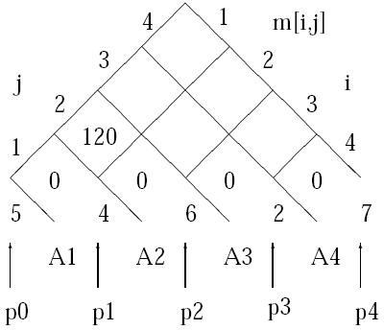
Example – Continued
Step 1: Computing m[1, 2]
By definition
m[1, 2]= min (m[1, k] + m[k + 1, 2] + p₀p_{k} p₂)
1≤k<2
= m[1, 1] + m[2, 2] + p₀p₁p₂ =120 .
Chain Matrix Multiplication
18 / 27

Slide 75
Example – Continued
Step 2: Computing m[2, 3]
By definition
m[2, 3]= min (m[2, k] + pm[k + 1, 3] + p₁p_{k} p₃)
2≤k<3
= m[2, 2] + m[3, 3] + p₁p₂p₃ =48 .
Chain Matrix Multiplication
19 / 27

Slide 76
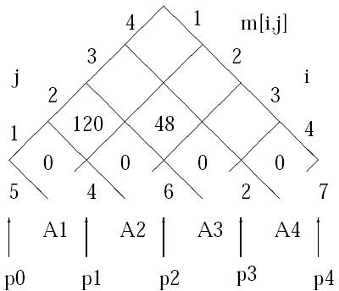
Example – Continued
Step 2: Computing m[2, 3]
By definition
m[2, 3]= min (m[2, k] + pm[k + 1, 3] + p₁p_{k} p₃)
2≤k<3
= m[2, 2] + m[3, 3] + p₁p₂p₃ =48 .
Chain Matrix Multiplication
19 / 27

Slide 77
Example – Continued
Step 3: Computing m[3, 4] By definition
m[3, 4]=
min
3≤k<4
(m[3, k] + m[k + 1, 4] + p₂p_{k} p₄)
Chain Matrix Multiplication
20 / 27

Slide 78
Example – Continued
Step 3: Computing m[3, 4]
By definition
m[3, 4]= min (m[3, k] + m[k + 1, 4] + p₂p_{k} p₄)
3≤k<4
= m[3, 3] + m[4, 4] + p₂p₃p₄ =84 .
Chain Matrix Multiplication
20 / 27

Slide 79
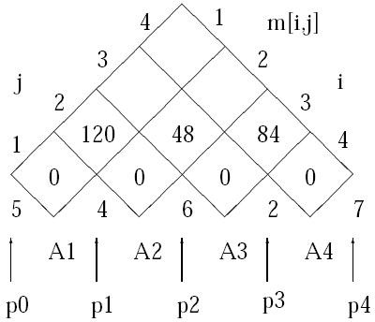
Example – Continued
Step 3: Computing m[3, 4]
By definition
m[3, 4]= min (m[3, k] + m[k + 1, 4] + p₂p_{k} p₄)
3≤k<4
= m[3, 3] + m[4, 4] + p₂p₃p₄ =84 .
Chain Matrix Multiplication
20 / 27

Slide 80
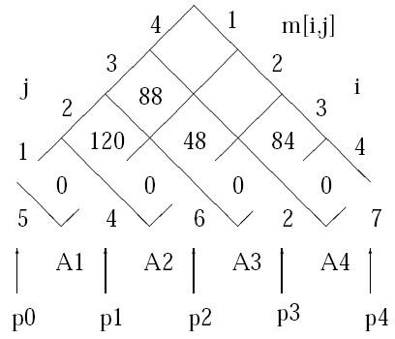
Example – Continued
Step 4: Computing m[1, 3] By definition
m[1, 3]=
min
1≤k<3
(m[1, k] + m[k + 1, 3] + p₀p_{k} p₃)
m[1, 1] + m[2, 3] + p p p
=min
0 1 3
m[1, 2] + m[3, 3] + p₀p₂p₃
=88 .
Chain Matrix Multiplication

Slide 81
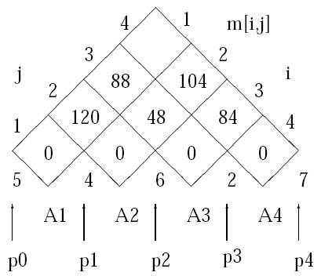
Example – Continued
Step 5: Computing m[2, 4] By definition
m[2, 4]=
min
2≤k<4
(m[2, k] + m[k + 1, 4] + p₁p_{k} p₄)
m[2, 2] + m[3, 4] + p p p
=min
1 2 4
m[2, 3] + m[4, 4] + p₁p₃p₄
=104 .
Chain Matrix Multiplication

Slide 82
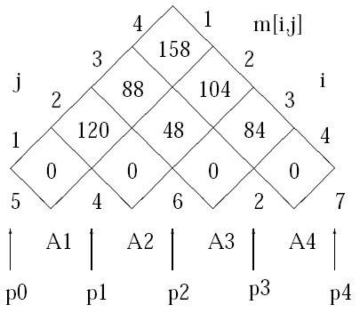
Example – Continued
Step 6: Computing m[1, 4] By definition
m[1, 4]=
min
1≤k<4
(m[1, k] + m[k + 1, 4] + p₀p_{k} p₄)
m[1, 1] + m[2, 4] + p p p
0 1 4
=min
m[1, 2] + m[3, 4] + p₀p₂p₄
m[1, 3] + m[4, 4] + p p p
0 3 4
=158 .
Chain Matrix Multiplication

Slide 83
Constructing a Solution
m[i, j ] only keeps costs but not actual multiplication sequence.
To solve problem, need to reconstruct multiplication sequence that yields m[1, n].
Solution: similar to previous DP algorithm(s) keep an auxillary array s[∗, ∗].
s[i , j ] = k where k is the index that achieves minimum in
m[i, j ] = _{i} min (m[i, k] + m[k + 1, j ] + p_{i−1}p_{k} p_{j} ) .
≤k<j
Chain Matrix Multiplication

Slide 84
Developing a Dynamic Programming Algorithm
Step 4: Constructing optimal solution
Idea: Maintain an array s[1..n, 1..n], where s[i , j ] denotes k for the optimal splitting in computing A_{i..j} = A_{i..k} A_{k+1..j} .
Chain Matrix Multiplication
25 / 27

Slide 85
Developing a Dynamic Programming Algorithm
Step 4: Constructing optimal solution
Idea: Maintain an array s[1..n, 1..n], where s[i , j ] denotes k for the optimal splitting in computing A_{i..j} = A_{i..k} A_{k+1..j} .
Question
How to Recover the Multiplication Sequence using s[i , j ]?
Chain Matrix Multiplication
25 / 27

Slide 86
Developing a Dynamic Programming Algorithm
Step 4: Constructing optimal solution
Idea: Maintain an array s[1..n, 1..n], where s[i , j ] denotes k for the optimal splitting in computing A_{i..j} = A_{i..k} A_{k+1..j} .
Question
How to Recover the Multiplication Sequence using s[i , j ]?
s[1, n]
^{(A}1 ^{· · · A}s[1,n]^{) (A}s[1,n]+1 ^{· · · A}n ⁾
Chain Matrix Multiplication
25 / 27

Slide 87
Developing a Dynamic Programming Algorithm
Step 4: Constructing optimal solution
Idea: Maintain an array s[1..n, 1..n], where s[i , j ] denotes k for the optimal splitting in computing A_{i..j} = A_{i..k} A_{k+1..j} .
Question
How to Recover the Multiplication Sequence using s[i , j ]?
s[1, n]
s[1, s[1, n]]
^{(A}1 ^{· · · A}s[1,n]^{) (A}s[1,n]+1 ^{· · · A}n ⁾
^{(A}1 ^{· · · A}s[1,s[1,n]]^{) (A}s[1,s[1,n]]+1 ^{· · · A}s[1,n]⁾
Chain Matrix Multiplication
25 / 27

Slide 88
Developing a Dynamic Programming Algorithm
Step 4: Constructing optimal solution
Idea: Maintain an array s[1..n, 1..n], where s[i , j ] denotes k for the optimal splitting in computing A_{i..j} = A_{i..k} A_{k+1..j} .
Question
How to Recover the Multiplication Sequence using s[i , j ]?
s[1, n]
s[1, s[1, n]]
s[s[1, n] + 1, n]
^{(A}1 ^{· · · A}s[1,n]^{) (A}s[1,n]+1 ^{· · · A}n ⁾
^{(A}1 ^{· · · A}s[1,s[1,n]]^{) (A}s[1,s[1,n]]+1 ^{· · · A}s[1,n]⁾
^{(A}s[1,n]+1 ^{· · · A}s[s[1,n]+1,n]^{) (A}s[s[1,n]+1,n]+1 ^{· · · A}n ⁾
Chain Matrix Multiplication
25 / 27

Slide 89
Developing a Dynamic Programming Algorithm
Step 4: Constructing optimal solution
Idea: Maintain an array s[1..n, 1..n], where s[i , j ] denotes k for the optimal splitting in computing A_{i..j} = A_{i..k} A_{k+1..j} .
Question
How to Recover the Multiplication Sequence using s[i , j ]?
s[1, n]
s[1, s[1, n]]
s[s[1, n] + 1, n]
^{(A}1 ^{· · · A}s[1,n]^{) (A}s[1,n]+1 ^{· · · A}n ⁾
^{(A}1 ^{· · · A}s[1,s[1,n]]^{) (A}s[1,s[1,n]]+1 ^{· · · A}s[1,n]⁾
^{(A}s[1,n]+1 ^{· · · A}s[s[1,n]+1,n]^{) (A}s[s[1,n]+1,n]+1 ^{· · · A}n ⁾
. .
. .
Chain Matrix Multiplication
25 / 27

Slide 90
Developing a Dynamic Programming Algorithm
Step 4: Constructing optimal solution
Idea: Maintain an array s[1..n, 1..n], where s[i , j ] denotes k for the optimal splitting in computing A_{i..j} = A_{i..k} A_{k+1..j} .
Question
How to Recover the Multiplication Sequence using s[i , j ]?
s[1, n]
s[1, s[1, n]]
s[s[1, n] + 1, n]
^{(A}1 ^{· · · A}s[1,n]^{) (A}s[1,n]+1 ^{· · · A}n ⁾
^{(A}1 ^{· · · A}s[1,s[1,n]]^{) (A}s[1,s[1,n]]+1 ^{· · · A}s[1,n]⁾
^{(A}s[1,n]+1 ^{· · · A}s[s[1,n]+1,n]^{) (A}s[s[1,n]+1,n]+1 ^{· · · A}n ⁾
. .
. .
Apply recursively until multiplication sequence is completely determined.
Chain Matrix Multiplication
25 / 27

Slide 91
Example 2:

Slide 92
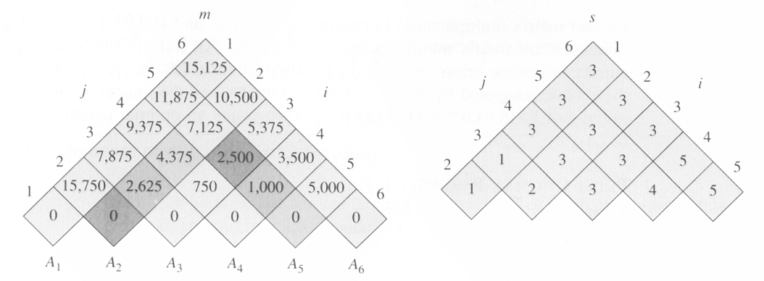
Order Matrix Size Products
A2 x A3 = 35 x 5 2,625
A1 (A2 x A3) = 30 X 5 5,250 + 2,625
the m and s table computed by
MATRIX-CHAIN-ORDER for n=6

Slide 93
m[2,5]=
min{
m[2,2]+m[3,5]+p₁p₂p₅=0+2500+35×15×20=13000,
m[2,3]+m[4,5]+p₁p₃p₅=2625+1000+35×5×20=7125,
m[2,4]+m[5,5]+p₁p₄p₅=4375+0+35×10×20=11374
}
=7125

Slide 94
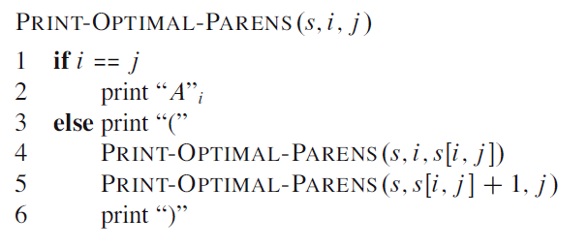
Constructing the optimal solution
example:

Slide 95
Constructing the optimal solution
example:

Slide 96
Step 4...
Example (Finding the Multiplication Sequence)
Consider n = 6. Assume array s[1..6, 1..6] has been properly constructed.
Chain Matrix Multiplication
26 / 27

Slide 97
Step 4...
Example (Finding the Multiplication Sequence)
Consider n = 6. Assume array s[1..6, 1..6] has been properly constructed. The multiplication sequence is recovered as follows.
Chain Matrix Multiplication
26 / 27

Slide 98
Step 4...
Example (Finding the Multiplication Sequence)
Consider n = 6. Assume array s[1..6, 1..6] has been properly constructed. The multiplication sequence is recovered as follows.
s[1, 6] = 3
Chain Matrix Multiplication
26 / 27

Slide 99
Step 4...
Example (Finding the Multiplication Sequence)
Consider n = 6. Assume array s[1..6, 1..6] has been properly constructed. The multiplication sequence is recovered as follows.
s[1, 6] = 3 (A₁A₂A₃)(A₄A₅A₆)
Chain Matrix Multiplication
26 / 27

Slide 100
Step 4...
Example (Finding the Multiplication Sequence)
Consider n = 6. Assume array s[1..6, 1..6] has been properly constructed. The multiplication sequence is recovered as follows.
s[1, 6] = 3 (A₁A₂A₃)(A₄A₅A₆)
s[1, 3] = 1
Chain Matrix Multiplication
26 / 27

Slide 101
Step 4...
Example (Finding the Multiplication Sequence)
Consider n = 6. Assume array s[1..6, 1..6] has been properly constructed. The multiplication sequence is recovered as follows.
s[1, 6] = 3
s[1, 3] = 1
(A₁A₂A₃)(A₄A₅A₆) (A₁(A₂A₃))
Chain Matrix Multiplication
26 / 27

Slide 102
Step 4...
Example (Finding the Multiplication Sequence)
Consider n = 6. Assume array s[1..6, 1..6] has been properly constructed. The multiplication sequence is recovered as follows.
s[1, 6] = 3
s[1, 3] = 1
s[4, 6] = 5
(A₁A₂A₃)(A₄A₅A₆) (A₁(A₂A₃))
Chain Matrix Multiplication
26 / 27

Slide 103
Step 4...
Example (Finding the Multiplication Sequence)
Consider n = 6. Assume array s[1..6, 1..6] has been properly constructed. The multiplication sequence is recovered as follows.
s[1, 6] = 3
s[1, 3] = 1
s[4, 6] = 5
(A₁A₂A₃)(A₄A₅A₆) (A₁(A₂A₃))
((A₄A₅)A₆)
Chain Matrix Multiplication
26 / 27

Slide 104
Step 4...
Example (Finding the Multiplication Sequence)
Consider n = 6. Assume array s[1..6, 1..6] has been properly constructed. The multiplication sequence is recovered as follows.
s[1, 6] = 3
s[1, 3] = 1
s[4, 6] = 5
(A₁A₂A₃)(A₄A₅A₆) (A₁(A₂A₃))
((A₄A₅)A₆)
Hence the final multiplication sequence is
Chain Matrix Multiplication
26 / 27

Slide 105
Step 4...
Example (Finding the Multiplication Sequence)
Consider n = 6. Assume array s[1..6, 1..6] has been properly constructed. The multiplication sequence is recovered as follows.
s[1, 6] = 3
s[1, 3] = 1
s[4, 6] = 5
(A₁A₂A₃)(A₄A₅A₆) (A₁(A₂A₃))
((A₄A₅)A₆)
Hence the final multiplication sequence is
(A₁(A₂A₃))((A₄A₅)A₆).
Chain Matrix Multiplication
26 / 27

Slide 106
The Dynamic Programming Algorithm
Matrix-Chain(p, n):// l is length of sub-chain
for i = 1 to n do m[i, i ] =
Chain Matrix Multiplication
27 / 27

Slide 107
The Dynamic Programming Algorithm
Matrix-Chain(p, n):// l is length of sub-chain
for i = 1 to n do m[i, i ] = 0;
;
for l =
Chain Matrix Multiplication
27 / 27

Slide 108
The Dynamic Programming Algorithm
Matrix-Chain(p, n):// l is length of sub-chain
for i = 1 to n do m[i, i ] = 0;
;
for l = 2 to
Chain Matrix Multiplication
27 / 27

Slide 109
The Dynamic Programming Algorithm
Matrix-Chain(p, n):// l is length of sub-chain
for i = 1 to n do m[i, i ] = 0;
;
for l = 2 to n do for i = 1 to
Chain Matrix Multiplication
27 / 27

Slide 110
The Dynamic Programming Algorithm
Matrix-Chain(p, n):// l is length of sub-chain
for i = 1 to n do m[i, i ] = 0;
;
for l = 2 to n do
for i = 1 to n − l + 1 do
j =
Chain Matrix Multiplication
27 / 27

Slide 111
The Dynamic Programming Algorithm
Matrix-Chain(p, n):// l is length of sub-chain
for i = 1 to n do m[i, i ] = 0;
;
for l = 2 to n do
for i = 1 to n − l + 1 do
j = i + l − 1;
m[i, j ] =
Chain Matrix Multiplication
27 / 27

Slide 112
The Dynamic Programming Algorithm
Matrix-Chain(p, n):// l is length of sub-chain
for i = 1 to n do m[i, i ] = 0;
;
for l = 2 to n do
for i = 1 to n − l + 1 do
j = i + l − 1; m[i, j ] = ∞; for k =
Chain Matrix Multiplication
27 / 27

Slide 113
The Dynamic Programming Algorithm
Matrix-Chain(p, n):// l is length of sub-chain
for i = 1 to n do m[i, i ] = 0;
;
for l = 2 to n do
for i = 1 to n − l + 1 do
j = i + l − 1; m[i, j ] = ∞; for k = i to
Chain Matrix Multiplication
27 / 27

Slide 114
The Dynamic Programming Algorithm
Matrix-Chain(p, n):// l is length of sub-chain
for i = 1 to n do m[i, i ] = 0;
;
for l = 2 to n do
for i = 1 to n − l + 1 do
j = i + l − 1;
m[i, j ] = ∞;
for k = i to j − 1 do
q =
Chain Matrix Multiplication
27 / 27

Slide 115
The Dynamic Programming Algorithm
Matrix-Chain(p, n):// l is length of sub-chain
for i = 1 to n do m[i, i ] = 0;
;
for l = 2 to n do
for i = 1 to n − l + 1 do
j = i + l − 1;
m[i, j ] = ∞;
for k = i to j − 1 do
q = m[i, k] +
Chain Matrix Multiplication
27 / 27

Slide 116
The Dynamic Programming Algorithm
Matrix-Chain(p, n):// l is length of sub-chain
for i = 1 to n do m[i, i ] = 0;
;
for l = 2 to n do
for i = 1 to n − l + 1 do
j = i + l − 1;
m[i, j ] = ∞;
for k = i to j − 1 do
q = m[i, k] + m[k + 1, j ] +
Chain Matrix Multiplication
27 / 27

Slide 117
The Dynamic Programming Algorithm
Matrix-Chain(p, n):// l is length of sub-chain
for i = 1 to n do m[i, i ] = 0;
;
for l = 2 to n do
for i = 1 to n − l + 1 do
j = i + l − 1;
m[i, j ] = ∞;
for k = i to j − 1 do
q = m[i, k] + m[k + 1, j ] + p[i − 1] ∗
Chain Matrix Multiplication
27 / 27

Slide 118
The Dynamic Programming Algorithm
Matrix-Chain(p, n):// l is length of sub-chain
for i = 1 to n do m[i, i ] = 0;
;
for l = 2 to n do
for i = 1 to n − l + 1 do
j = i + l − 1;
m[i, j ] = ∞;
for k = i to j − 1 do
q = m[i, k] + m[k + 1, j ] + p[i − 1] ∗ p[k] ∗
Chain Matrix Multiplication
27 / 27

Slide 119
The Dynamic Programming Algorithm
Matrix-Chain(p, n):// l is length of sub-chain
for i = 1 to n do m[i, i ] = 0;
;
for l = 2 to n do
for i = 1 to n − l + 1 do
j = i + l − 1;
m[i, j ] = ∞;
for k = i to j − 1 do
q = m[i, k] + m[k + 1, j ] + p[i − 1] ∗ p[k] ∗ p[j ];
Chain Matrix Multiplication
27 / 27

Slide 120
The Dynamic Programming Algorithm
Matrix-Chain(p, n):// l is length of sub-chain
for i = 1 to n do m[i, i ] = 0;
;
for l = 2 to n do
for i = 1 to n − l + 1 do
j = i + l − 1;
m[i, j ] = ∞;
for k = i to j − 1 do
q = m[i, k] + m[k + 1, j ] + p[i − 1] ∗ p[k] ∗ p[j ];
if q < m[i, j ] then
m[i, j ] =
Chain Matrix Multiplication
27 / 27

Slide 121
The Dynamic Programming Algorithm
Matrix-Chain(p, n):// l is length of sub-chain
for i = 1 to n do m[i, i ] = 0;
;
for l = 2 to n do
for i = 1 to n − l + 1 do
j = i + l − 1;
m[i, j ] = ∞;
for k = i to j − 1 do
q = m[i, k] + m[k + 1, j ] + p[i − 1] ∗ p[k] ∗ p[j ];
if q < m[i, j ] then
m[i, j ] = q;
s[i, j ] =
Chain Matrix Multiplication
27 / 27

Slide 122
The Dynamic Programming Algorithm
Matrix-Chain(p, n):// l is length of sub-chain
for i = 1 to n do m[i, i ] = 0;
;
for l = 2 to n do
for i = 1 to n − l + 1 do
j = i + l − 1;
m[i, j ] = ∞;
for k = i to j − 1 do
q = m[i, k] + m[k + 1, j ] + p[i − 1] ∗ p[k] ∗ p[j ];
if q < m[i, j ] then
m[i, j ] = q;
s[i, j ] = k;
end
end
end end return
Chain Matrix Multiplication
27 / 27

Slide 123
The Dynamic Programming Algorithm
Matrix-Chain(p, n):// l is length of sub-chain
for i = 1 to n do m[i, i ] = 0;
;
for l = 2 to n do
for i = 1 to n − l + 1 do
j = i + l − 1;
m[i, j ] = ∞;
for k = i to j − 1 do
q = m[i, k] + m[k + 1, j ] + p[i − 1] ∗ p[k] ∗ p[j ];
if q < m[i, j ] then
m[i, j ] = q;
s[i, j ] = k;
end
end
end
end
return m and s;(Optimum in
Chain Matrix Multiplication
27 / 27

Slide 124
The Dynamic Programming Algorithm
Matrix-Chain(p, n):// l is length of sub-chain
for i = 1 to n do m[i, i ] = 0;
;
for l = 2 to n do
for i = 1 to n − l + 1 do
j = i + l − 1;
m[i, j ] = ∞;
for k = i to j − 1 do
q = m[i, k] + m[k + 1, j ] + p[i − 1] ∗ p[k] ∗ p[j ];
if q < m[i, j ] then
m[i, j ] = q;
s[i, j ] = k;
end
end
end
end
return m and s;(Optimum in m[1, n])
Complexity: The loops are nested three levels deep.
Chain Matrix Multiplication
27 / 27

Slide 125
The Dynamic Programming Algorithm
Matrix-Chain(p, n):// l is length of sub-chain
for i = 1 to n do m[i, i ] = 0;
;
for l = 2 to n do / l is the chain length
for i = 1 to n − l + 1 do
j = i + l − 1;
m[i, j ] = ∞;
for k = i to j − 1 do
q = m[i, k] + m[k + 1, j ] + p[i − 1] ∗ p[k] ∗ p[j ];
if q < m[i, j ] then
m[i, j ] = q;
s[i, j ] = k;
end
end
end
end
return m and s;(Optimum in m[1, n])
Complexity: The loops are nested three levels deep. Each loop index takes on ≤ n values.
Chain Matrix Multiplication
27 / 27

Slide 126
The Dynamic Programming Algorithm
Matrix-Chain(p, n):// l is length of sub-chain
for i = 1 to n do m[i, i ] = 0;
;
for l = 2 to n do
for i = 1 to n − l + 1 do
j = i + l − 1;
m[i, j ] = ∞;
for k = i to j − 1 do
q = m[i, k] + m[k + 1, j ] + p[i − 1] ∗ p[k] ∗ p[j ];
if q < m[i, j ] then
m[i, j ] = q;
s[i, j ] = k;
end
end
end
end
return m and s;(Optimum in m[1, n])
Complexity: The loops are nested three levels deep. Each loop index takes on
≤ n values. Hence the time complexity is O(n³ .
Chain Matrix Multiplication
27 / 27

Slide 127
The Dynamic Programming Algorithm
Matrix-Chain(p, n):// l is length of sub-chain
for i = 1 to n do m[i, i ] = 0;
;
for l = 2 to n do
for i = 1 to n − l + 1 do
j = i + l − 1;
m[i, j ] = ∞;
for k = i to j − 1 do
q = m[i, k] + m[k + 1, j ] + p[i − 1] ∗ p[k] ∗ p[j ];
if q < m[i, j ] then
m[i, j ] = q;
s[i, j ] = k;
end
end
end
end
return m and s;(Optimum in m[1, n])
Complexity: The loops are nested three levels deep. Each loop index takes on
3 2
≤ n values. Hence thetime complexityis O(n ). Space complexityis Θ( n ).
Version of October 26, 2016 Chain Matrix Multiplication

Slide 128
Reference
Introduction to Algorithms
Thomas H. Cormen
Chapter # 15

